Slide 1
Timelines and Sequencing of History
YEAR 7 HASS
2022

Slide 2
Turn and talk to your partner
What is history?
Why do we study history?

Slide 3
Definition: History is the study of past events connected with a particular person or thing

Slide 4
Consider these quotes..
“We are not makers of history, we are made by history”
“Those who do not remember the past are condemned to repeat it”
“A people without the knowledge of their past history, origin and culture is like a tree without roots”

Slide 5
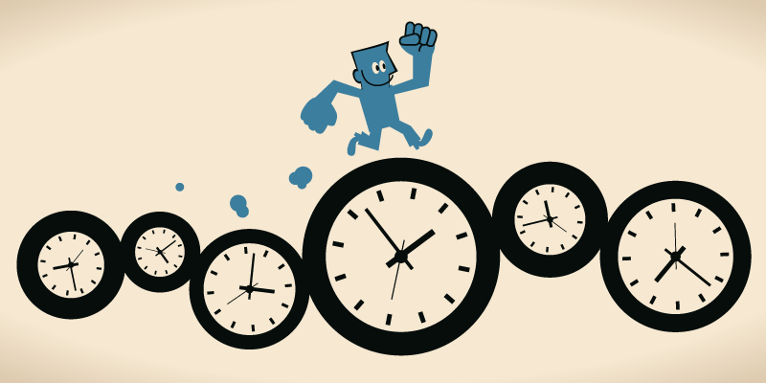
Timelines: What is a timeline?
A visual representation of a period of time, arranged in chronological order.
A timeline can show the order of events for one day, a year, or for any other time frame.
Chronology: A record of events in the order they took place.
Chronological order: The order in which events have taken place.
Add to your glossary!

Slide 6

Timelines: How can they help me?
They highlight what the most important events were
We can see the sequence of events in the correct order
They help us divide large sections of time into smaller periods
It allows us to see the big picture- the relationships between events (cause and effect)

Slide 7
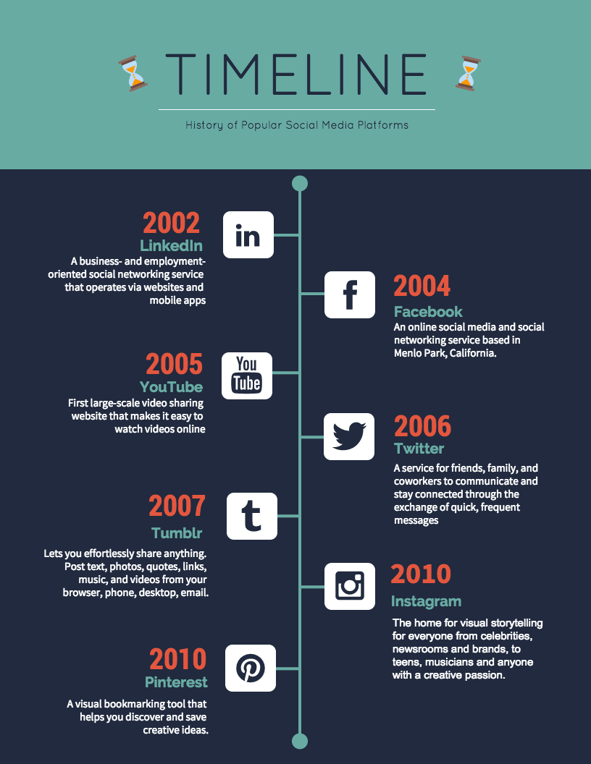
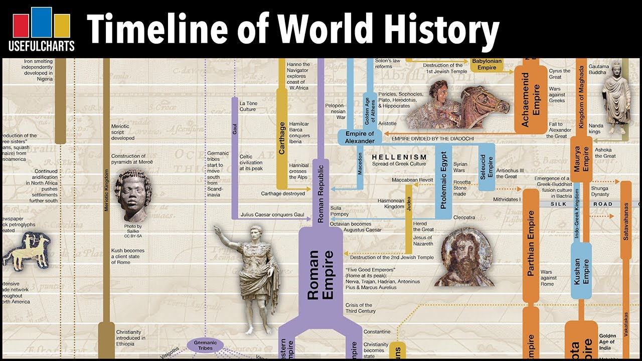
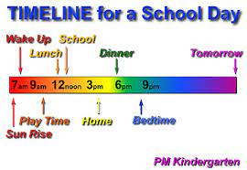
Examples of timelines

Slide 8
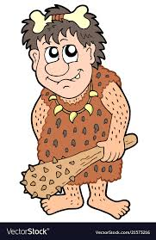
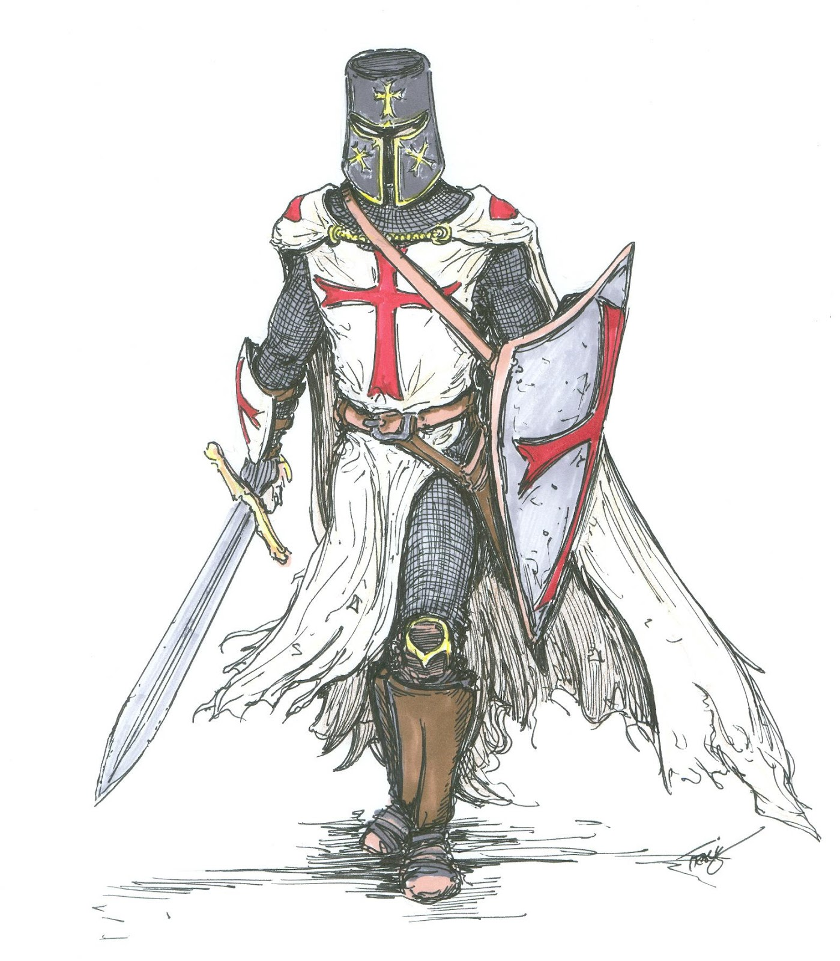
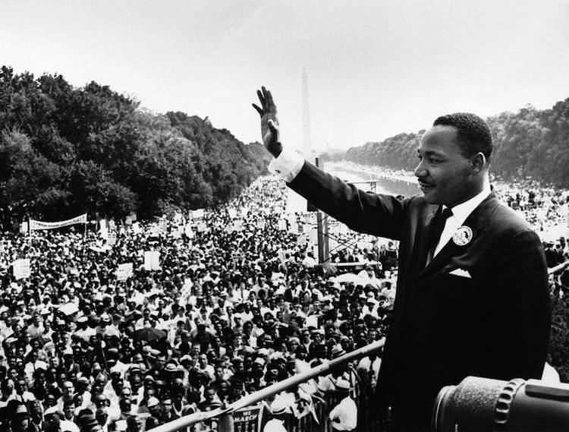
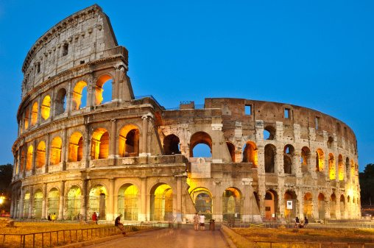
A timeline of the world
A timeline of the world can be broken up into 4 main periods of history:
Prehistoric Period
3000 BC – 2000 BC
Ancient History
2000 BC – 500 AD
Medieval History
500 AD – 1500 AD
Modern History
1500 AD – Present day
In Year 7, we focus on prehistory and ancient history.
Prehistory covers many tens of thousands of years, so we usually speak in blocks of 1000 years.
Historians studying later times sometimes concentrate on centuries (blocks of 100 years) or decades (10 years).

Slide 9
A timeline of the world
Historians often talk about years as being BCE/BC or CE/AD
This is another way of dividing time.
A timeline of the world can be broken up into 4 main periods of history:
Prehistoric Period
3000 BC – 2000 BC
Ancient History
2000 BC – 500 AD
Medieval History
500 AD – 1500 AD
Modern History
1500 AD – Present day
What do these mean?
Notes:
As you know, as each year passes we count up E.g. 2009, 2010, 2011. This system has been in place ever since christ was born. The AD refers to Anno Domini, Latin for ‘in the year of our lord’.
BC: Follows the time before Christ’s birth. The counting system for BC is reverse of AD. As the years pass, we count down. E.g. 500BC, 499 BC, 498 BC, all the way down to 1BC.

Slide 10
Counting Time
In Australia, the system we use to count years was first used in Christian countries.
AD = anno Domini (Latin for ‘in the year of our Lord).
Therefore, 2022 AD means 2022 years since the birth of Christ.
BC = before ‘Christ’.

Slide 11
What does BC & AD stand for?
Before Christ
-(BC)
Anno Domini
+(AD)
500 years
2022 years
100 BCE
500 CE
2000 AD
2022 AD
NOW!
500 BCE
100 CE
BC years move backwards in time starting from 1.
AD years move forward in time from 1 until you reach today.
Notes:
As you know, as each year passes we count up E.g. 2009, 2010, 2011. This system has been in place ever since christ was born. The AD refers to Anno Domini, Latin for ‘in the year of our lord’.
BC: Follows the time before Christ’s birth. The counting system for BC is reverse of AD. As the years pass, we count down. E.g. 500BC, 499 BC, 498 BC, all the way down to 1BC.

Slide 12
What does BCE & CE stand for?
Before Common
Era
-(BCE)
Common Era
+(CE)
500 years
2022 years
500 CE
2000 CE
2022 CE
NOW!
500 BCE
100 BCE
100 CE
BCE years move backwards in time starting from 1.
CE years move forward in time from 1 until you reach today.
Notes:
Historians have come up for a neutral term for AD and BC, as only 1/3 of world’s population is charistian.
Time can also be divided into periods of one hundred years called ‘centuries’.

Slide 13
Activity 1 – Complete your timeline with the following dates.
54BC
200AD
140BC
1650AD
1880AD
390BC
1988AD
- (BCE/BC)
+(CE/AD)
500BC
2018 AD
NOW!

Slide 14
Activity 2:
1.How many years are between 546BC and 540BC?
2.How many years before 1AD is 76 BC?
3.How many years after 1 AD is your year of birth?
4.How many years before 1AD is 700BC?
Notes:
6
77
2008 or 2009
799

Slide 15
BP and ‘Circa’
In prehistory, many dates are uncertain. We often use ‘BP’ (Before the Present) to indicate about how long ago something happened.
When dates are uncertain, we often use ‘circa’ (Latin for ‘around’) by putting a ‘c’ before the year. E.g. c. 6000 BCE.

Slide 16


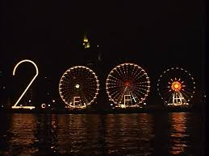
Periods of Time
Key words (for word wall)
Decade: 10 years
Century: 100 years
Millennia: 1000 years
The periods of time can be separated into years, decades, centuries and millennia.
Decade
a period of 10 years
Century
a period of 100 years
Millennia
a period of 1000 years

Slide 17
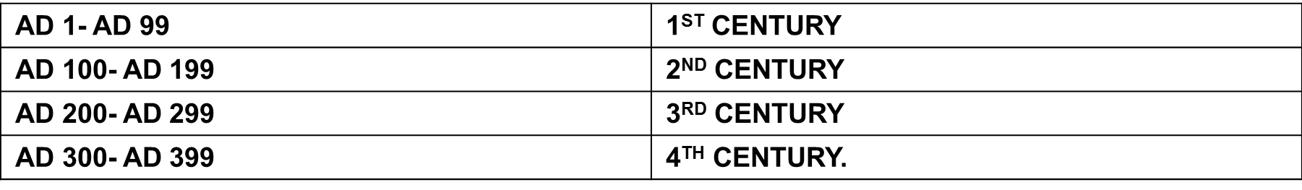
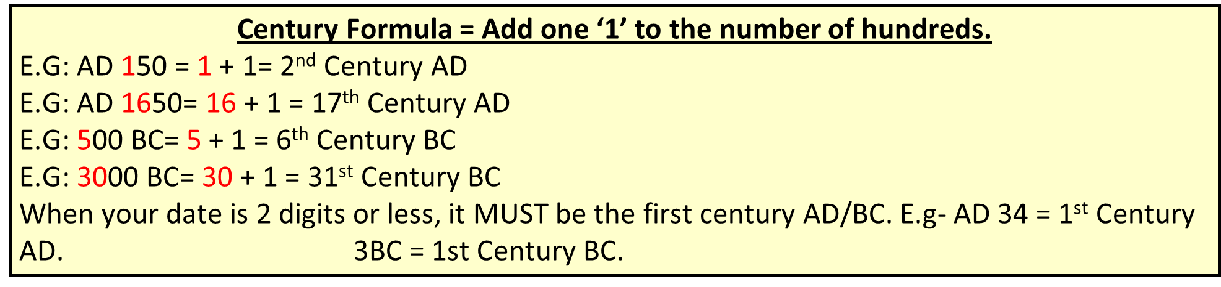
How do I work out the century?
We are currently living in the 21st century. This is because it is the 21st century after the year AD1.
Finding out which year is in which century can be tricky business. There is a formula that we can use to work out the centuries.

Slide 18
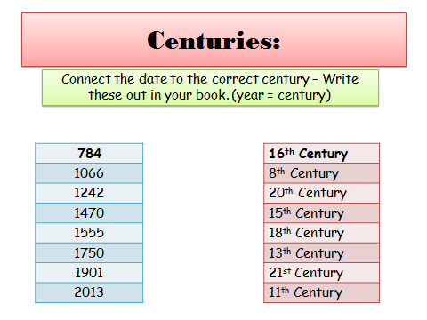

Slide 19
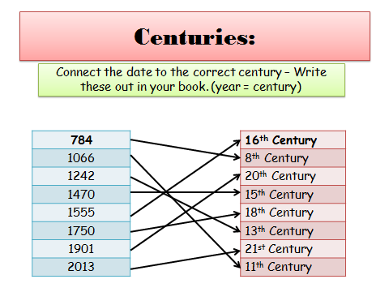

Slide 20
Do Now – 10 mins
Create a timeline in your workbook- 10cm long.
Guess where the following events would go on your timeline:
1. Donald Trump becomes President of the USA
2. The first COVID case is discovered in Australia
3. The Reject Shop comes to Narrogin
4. Mrs Flavel graduates high school
2012
2022
Notes:
2016
2020
2022
2012

Slide 21
Create a timeline of your life.
You will need a ruler, pencil/pen and your workbook.
Step 1: Rule a line in your workbook. Put two arrows at the end.
Step 2: Create a title of your timeline e.g. ‘My life in chronological order’
Step 3: Divide the line into the amount of years that you have lived (If you are 12 years old, this means you need to divide it into 12 sections).
Step 4: Think of 5 significant events and place them on your timeline.
*Make sure that they are in the correct order. You may add extra events if you like.
Extension: Imagine you are a historian who deals with time and chronology every day. What do you think would be a more useful tool: a timeline of events or a list of dates? Explain your answer.
Notes:
Give choice – fictional character

